Slide 1

Role of communication skill to improve patient safety
Col(Dr.) Ajit Kumar Dy.Director Administration
AIIMS,Bhopal

Slide 2
वाचं विश्वस्य धारणम्
"Communication holds the world together.”

Slide 3
“Communication is the process of passing information and understanding from one person to another “ - Keith Devis
According to Peter Drucker, “ Good communication is the foundation for sound administration .

Slide 4
Communication in healthcare is crucial for providing high-quality patient care, ensuring patient safety, and enhancing overall healthcare outcomes. Effective communication is defined not only by the exchange of information but also by how it is conveyed, understood, and acted upon by all parties involved in patient care. This includes communication among healthcare providers, between providers and patients, and within the healthcare system as a whole.

Slide 5
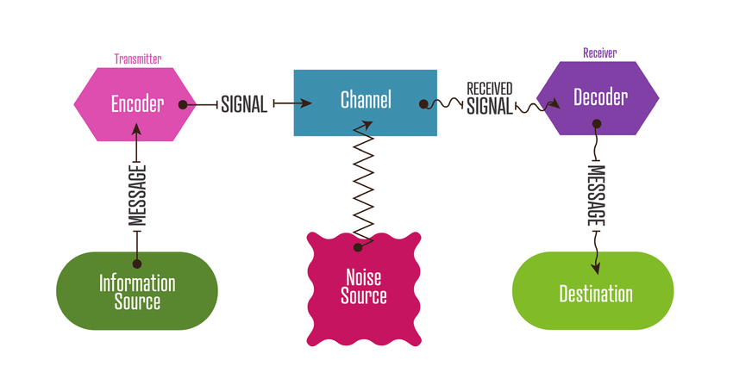
Communication process

Slide 6
Key Aspects of Communication in Healthcare
Verbal Communication
Verbal communication includes face-to-face interactions, phone calls, and virtual communication between healthcare professionals, as well as between healthcare providers and patients.
- Clarity and Precision: When speaking, especially in medical settings, clarity is critical. Misunderstandings in verbal communication can lead to incorrect diagnoses, improper treatments, and medication errors.
- Use of Standardized Language: To avoid ambiguity, many healthcare settings use standardized communication protocols (such as SBAR: Situation, Background, Assessment, Recommendation) to structure communication, particularly in critical situations like handoffs or during emergencies

Slide 7
Non-verbal Communication
Non-verbal cues, such as body language, facial expressions, tone of voice, and eye contact, play a significant role in communication, especially when interacting with patients.
-Building Trust: Good non-verbal communication helps build trust with patients and enhances rapport. For example, maintaining eye contact and open body posture signals attentiveness and empathy.
- Recognizing Patient Cues: Non-verbal communication is also key for healthcare professionals to assess patient emotions and concerns that may not be verbally expressed, such as anxiety, fear, or pain.

Slide 8
Written Communication
Written communication includes patient charts, progress notes, prescriptions, and other medical records. Proper documentation ensures that accurate information about a patient's care is conveyed across different shifts, teams, or healthcare settings.
- Accuracy and Legibility: In written communication, especially with medical records or prescriptions, accuracy and legibility are paramount. Illegible handwriting or poorly worded notes can lead to misinterpretation and errors.
- Electronic Health Records (EHRs): The use of EHRs helps streamline communication by providing a centralized, real-time source of patient information, improving care coordination and reducing errors.

Slide 9
Patient-Centered Communication
Communicating effectively with patients involves understanding their perspectives, preferences, and needs. Patient-centered communication fosters collaboration, trust, and informed decision-making.
- Active Listening: Healthcare professionals should actively listen to patients, giving them time to express their concerns and ensuring they feel heard and respected.
- Shared Decision-Making: Effective communication encourages shared decision-making, where healthcare providers work together with patients to choose the best treatment plan based on mutual understanding and respect.

Slide 10
Interdisciplinary Team Communication
Healthcare often involves a team of professionals working together to care for a patient (doctors, nurses, pharmacists, dietitians, social workers, etc.). Effective communication within the team ensures that each member is aware of the patient’s status, treatment plan, and any changes in their condition.
- Team Huddles and Rounds: Regular communication meetings, such as team huddles or rounds, allow for the exchange of crucial information, the identification of potential issues, and the coordination of care.
- Clarifying Roles: Clear communication about each team member’s role and responsibilities helps prevent duplication of efforts, gaps in care, and confusion

Slide 11
Communication in High-Risk Situations
In emergency situations, during medical crises, or in complex procedures, communication is especially important to ensure that everyone involved has a clear understanding of what is happening and what actions need to be taken.
- Emergency Protocols: Using standardized communication protocols, such as the “SBAR” framework, during emergencies or critical care ensures that important information is conveyed quickly and accurately.
- Simulation and Training: Regular simulation exercises and training in communication skills for high-pressure situations help healthcare teams develop the ability to stay focused and clear under stress.

Slide 12
Patient Safety
Patient safety is a critical component of healthcare quality, focusing on the prevention of errors, adverse events, and harm to patients during the delivery of medical care. Ensuring patient safety involves protecting patients from risks and creating systems that help healthcare providers offer the highest standard of care in a safe, efficient, and effective manner. A commitment to patient safety includes minimizing the likelihood of harm while promoting a culture of transparency, accountability, and continuous improvement.

Slide 13
PATIENT SAFETY :GLOBAL ISSUE
One in 10 patients are harmed in healthcare, and more than three million deaths occur annually worldwide due to patient safety incidents.
In the UK, over 1700 lives are lost per year because of medication errors alone,² and between April 2022 and June 2022 alone, 652 246 patient safety incidents were reported in England.
In the US in 1999, the Institute of Medicine⁴ reported that between 44 000 and 98 000 people in the US die annually from preventable errors.
Internationally, over 50% of patient harm is preventable and is attributed largely to medication errors.
Patient safety incidents also impose an economic burden. In high-income countries, up to 15% of hospital expenditure is attributed to resource wastage following lapses in patient safety.
Although the causes of patient safety incidents are multifaceted,¹ research shows that ineffective communication contributes to unexpected care events and adverse care outcomes.
The Joint Commission, a non-profit organisation responsible for objectively evaluating US healthcare organisations, reported that poor communication is a contributing factor in over 60% of all hospital adverse events in the USA. Both poor communication between healthcare practitioners, and between practitioners and patients can result in misunderstandings that lead to medical errors through misdiagnosis or suboptimal treatments.
9.5% of the total population reported medication-related mistakes in India, while the treatable mortality rate stood at 180 per 100K population in India, much higher than in developed countries, indicating the need for proper patient safety protocols.

Slide 14
Aspects of patient safety
Prevention of Medical Errors
- Types of Medical Errors: Medical errors can be categorized into several types, including medication errors, diagnostic errors, surgical errors, procedural mistakes, and errors of omission (when necessary care is not provided).
- Root Cause Analysis (RCA): After an error or adverse event, healthcare organizations often conduct an RCA to understand the underlying causes and develop strategies to prevent recurrence. This approach emphasizes systemic changes rather than individual blame

Slide 15
Culture of Safety
- Reporting and Transparency: A culture of safety encourages open reporting of errors, near misses, and safety concerns without fear of retribution. When staff feel safe to report mistakes, institutions can learn from them and improve care processes

Slide 16
Infection Prevention and Control
- Healthcare-Associated Infections (HAIs): Patients in healthcare settings are at risk for infections that can occur during hospital stays, surgery, or procedures. Preventing HAIs is a fundamental aspect of patient safety.
- Hand Hygiene: Regular handwashing by healthcare professionals and using personal protective equipment (PPE) are among the simplest yet most effective strategies to prevent the spread of infections.
- Antibiotic Stewardship: Using antibiotics judiciously and according to guidelines helps prevent the overuse and misuse of antibiotics, which can lead to antibiotic resistance and increased infection risks.

Slide 17
Medication Safety
- Avoiding Medication Errors: Medication errors can occur during prescribing, dispensing, administering, or monitoring medications. Strategies to reduce errors include using electronic health records (EHRs), barcode scanning, and having a second check for high-risk medications.
- Medication Reconciliation: Ensuring accurate and complete lists of medications when patients are admitted, transferred, or discharged reduces the risk of omissions, duplications, or drug interactions that could harm patients.
- Patient Education: Educating patients about their medications (e.g., the purpose, side effects, proper dosage, and when to take them) empowers them to be active participants in their safety

Slide 18
Patient Identification and Verification
- Two-Patient Identifier Rule: Ensuring that the correct patient receives the correct treatment is vital for patient safety. The "two identifiers" (e.g., name and date of birth) are used to verify patient identity before administering medications or performing procedures.
- Barcoding and Technology: Technologies like barcode scanning for patient identification and medication administration further reduce the risk of human error.

Slide 19
Surgical and Procedural Safety
- Surgical Site Infections (SSIs): To prevent SSIs, strict sterilization protocols, use of prophylactic antibiotics, and proper surgical hand scrubbing are required.
- Correct-Site Surgery: One of the most widely discussed issues in patient safety is "wrong-site surgery." This is prevented by the use of checklists, surgical timeouts, and clearly marked patient sites before any procedure.
- Team Briefings and Huddles: Pre-surgical briefings and time-outs, where the surgical team confirms the procedure and patient details, reduce the risk of errors during surgery.

Slide 20
Safe Transitions and Handoffs
- Shift Handover: When a patient’s care is handed over from one provider to another (e.g., during shift changes or transfers between units), it is essential that the information is accurately communicated. Miscommunication during handoffs is a leading cause of medical errors.

Slide 21
Importance of Communication for Patient Safety
Effective communication directly impacts patient safety in multiple ways:
- Prevents Errors: Clear communication helps prevent misunderstandings that could lead to medical errors, such as wrong medications, incorrect dosages, or delayed treatments.
- Improves Outcomes: When healthcare providers communicate effectively, they are more likely to make correct diagnoses and treatment plans, leading to better health outcomes.
- Facilitates Patient Engagement: Good communication allows patients to better understand their condition and the treatment process, empowering them to take an active role in their care and reducing the likelihood of adverse events.

Slide 22
Improves Continuity of Care
In many healthcare settings, patients are cared for by multiple professionals and may be transferred between departments or facilities. Effective handoffs—clear, structured communications when care is transferred—ensure that all team members know the patient’s condition, treatment needs, and any special considerations.

Slide 23
Supports Rapid Response to Deterioration
When patients show signs of deterioration, timely communication allows for faster intervention. Communication protocols, such as early warning scores, help nurses and physicians identify and respond quickly to changes, reducing the chance of escalation to severe conditions.

Slide 24
Builds a Culture of Safety
Open communication contributes to a culture where healthcare professionals feel comfortable voicing concerns and reporting errors. This transparency promotes learning from mistakes, refining processes, and ultimately creating safer environments for patients.

Slide 25
Reduces Misunderstandings Due to Language Barriers
In diverse patient populations, language barriers can be a major source of misunderstanding. Providing interpretation services, written translations, and culturally sensitive communication can prevent errors and improve outcomes for non-native speakers or those with limited health literacy.

Slide 26
Strengthens Team Collaboration
Clear communication fosters collaboration across multidisciplinary teams, allowing professionals to work together effectively. Tools like SBAR (Situation, Background, Assessment, Recommendation) provide structured formats for conveying critical information, particularly in high-stakes situations.

Slide 27
Strengthens Team Collaboration
Clear communication fosters collaboration across multidisciplinary teams, allowing professionals to work together effectively. Tools like SBAR (Situation, Background, Assessment, Recommendation) provide structured formats for conveying critical information, particularly in high-stakes situations.

Slide 28
THANK YOU

